Slide 1


The Roadmap for Becoming More Agile
Stephen Townsend, PMI Director, Network Programs

Slide 2
Learning Objectives
As a result of attending this session, individuals will be able to:
Consider how to adapt sponsor behaviors to enable agile and agility
Better articulate the concepts of agile and agility
Guide thoughts and actions using agile and agility sign-posts
Immediately apply learnings from the session within any teams

Slide 3
Exercise
Take 3 minutes individually to identify keywords you associate with:
Agile
Agility
Base the keywords not on what you have heard but what you personally know and/or feel about the terms
Take 5 minutes as a group to use agreed keywords to create definitions for each term.

Slide 4

Agile/Agility: Either/Or Both/And?
Agility
The capability to quickly sense and adapt to external and internal changes to deliver relevant results in a productive and cost-effective manner.
Agile
A mindset based on a set of values and key principles designed to better enable collaborative work, deliver continuous value and satisfy customers.

Slide 5

“Agile” Is Not New and Is Still Evolving!
Major Evolutionary Waves
World War II/Cold War
Space Race
Product development and manufacturing
Lean
Kanban
Software development
Agile Manifesto & 12 Principles
Scaling frameworks and DevOps

Slide 6

Sign-Posts

Slide 7


Sign-Post: Embrace Ambiguity & Change

Slide 8
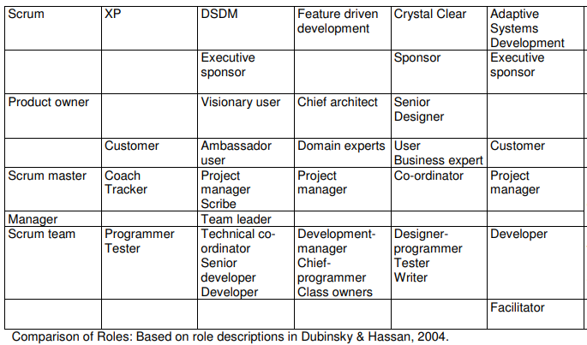
Some Agile Team Methods Exclude Sponsors
Improvise solutions that work for you and the team!

Slide 9
Most Important Executive Sponsor Actions
Removing roadblocks
Helping the project team understand the alignment of the project or program to the organization’s strategy
Championing the project or program
Adding resources when appropriate
Acting quickly to resolve issues
Pulse of the Profession® In-Depth: Executive Sponsor Engagement — Top Driver of Project and Program Success

Slide 10
Sponsors Enable Benefits of Agile Development
If you want agile to support… | You need to….
Accelerated delivery of solutions | Provide feedback and decisions as quickly as possible. Ensure that decision making is pushed to front line staff as much as possible.
Delivery of value to customers | Ensure that the Product Owner/customer representative actively participates.
Highly productive teams | Enable workspaces and tools that facilitate communication and collaboration.
Highly skilled teams | Allow time for reflection and improvement as part of the team’s work effort.

Slide 11
Same Failure Factors in Agile and Waterfall
Lack of executive support
Lack of clearly defined goals
Lack of delegation of authority
Inadequate capabilities for control
Inadequate planning and review
Lack of access to information and communication
Inadequate staff resources
Inadequate project team capabilities
Team lacks commitment to the project goals
Poor customer engagement
Bureaucracy
Extracted from the work of Belassi and Tukel (1996) based on previous literature

Slide 12
Discussion
Today, what inhibits or limits your ability to embrace agile and agility?
Which conditions can you control or change?
How can you help your teams embrace new ways of working?
What lessons learned from your past experiences might apply?

Slide 13
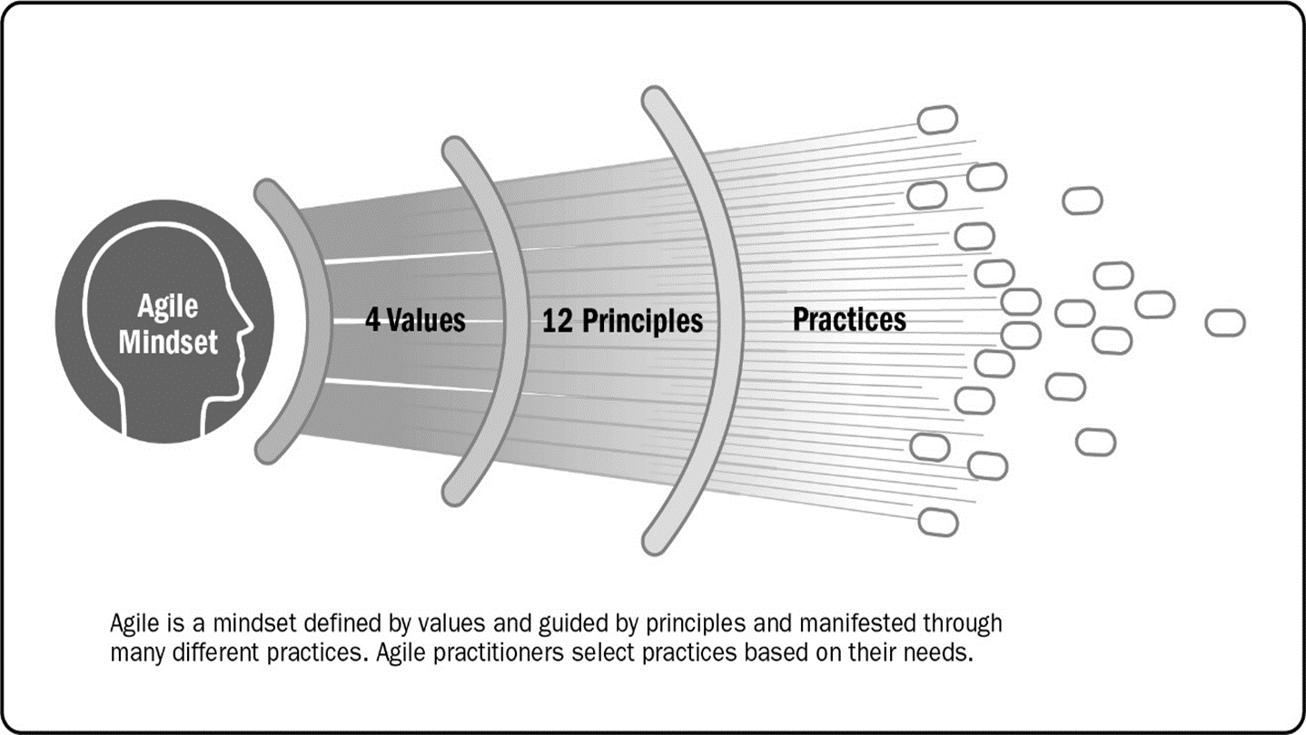
Sign-Post: Marry Principles & Practice
Source: PMI Agile Practice Guide.
Notes:
Key messages:
An agile mindset is influenced by values and principles
Practices enable behaviors that support delivery of results in the development context
Whichever practices align with the values and principles are considered agile

Slide 14
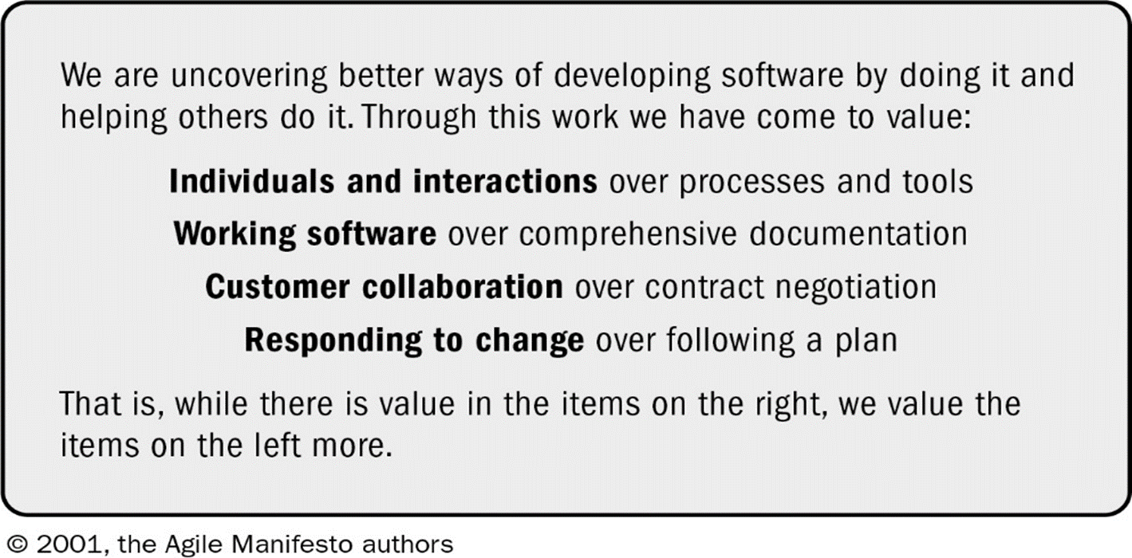
Sign-Post: Marry Principles & Practice

Slide 15
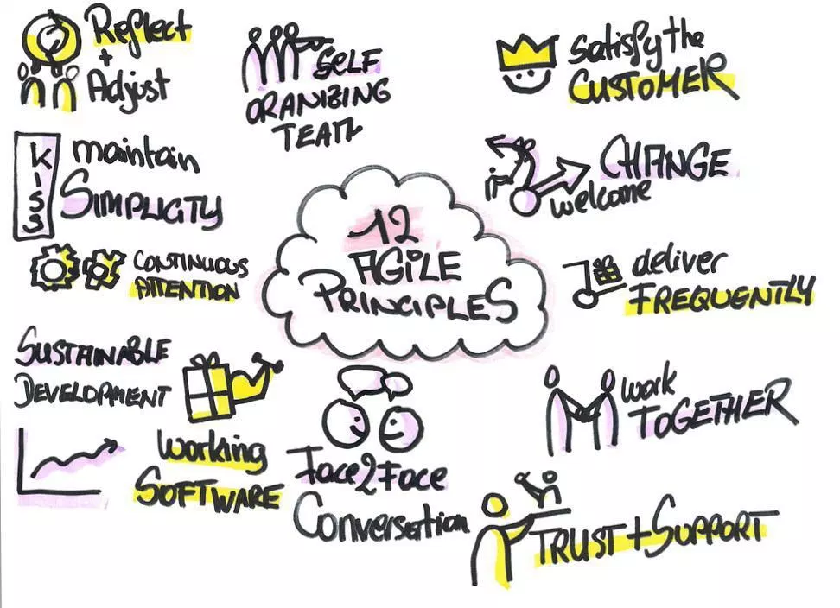
Sign-Post: Marry Principles & Practice
http://www.nathaliekarasek.com/12-agile-principles/

Slide 16
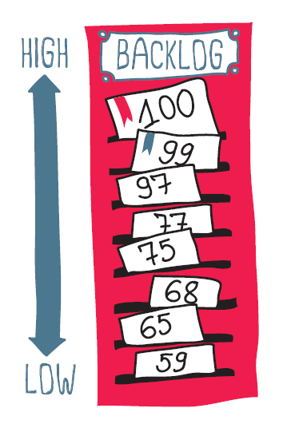
Agile-aligned Practices - Backlog
https://www.telerik.com/blogs/the-importance-of-prioritizing-and-sizing-your-backlog-for-agile-planning

Slide 17
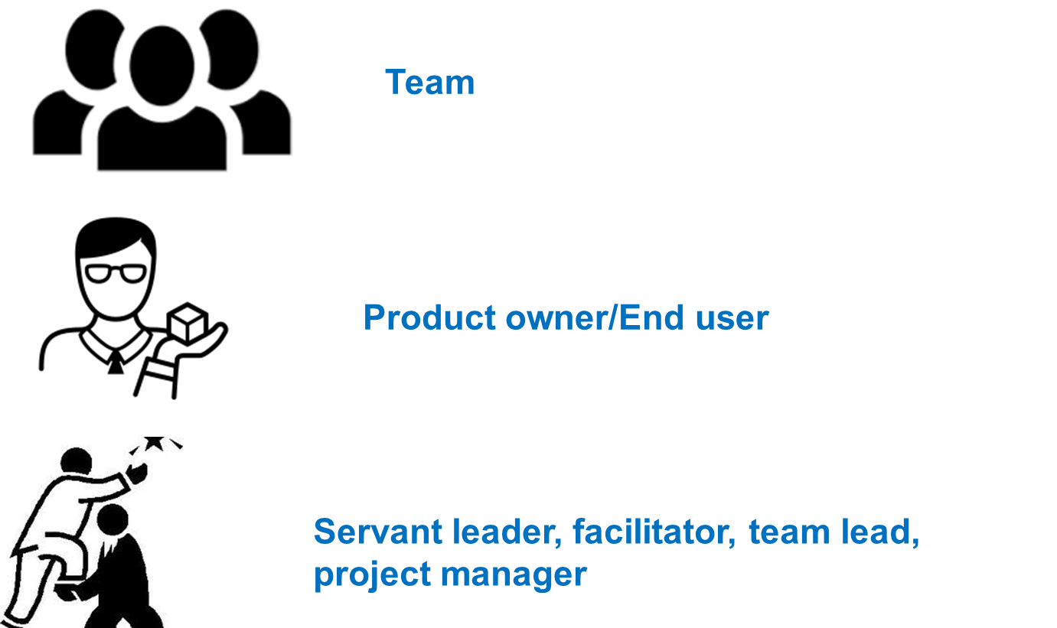
Agile-aligned Practices - Roles

Slide 18
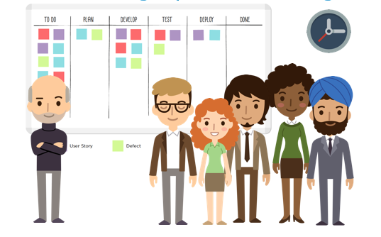
Agile-aligned Practices – Daily Standup
http://www.full-stackagile.com/2018/03/01/dont-rename-the-sprint-review/.

Slide 19

Agile-aligned Practices - Demos
http://www.full-stackagile.com/2018/03/01/dont-rename-the-sprint-review/.

Slide 20
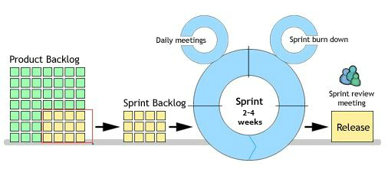
Agile-aligned Practices – Sprint/Iteration
https://deanhume.com/the-ideal-sprint-length/

Slide 21
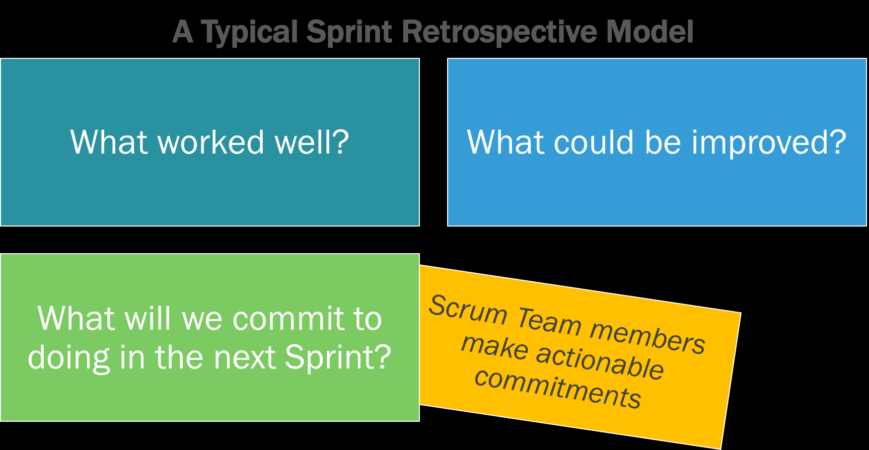
Agile-aligned Practices - Retrospectives
https://www.scrum.org/resources/what-is-a-sprint-retrospective

Slide 22
Agile-aligned Practices: Other Tools/Practices
Kanban board – visualizing work to enhance the value stream
Paired work – quality testing and development together
DevOps – development, testing and release aligned with agile values and principles
Scaling frameworks – mechanisms for leveraging agile development across multiple teams with a focus on integration, alignment and frequent delivery
Blended approaches – combining two or more agile practices, e.g. Scrumban

Slide 23

Sign-Post: Check Your Mental Models
Notes:
Key Message:
A mental model:
Is an explanation of someone's thought process about how something works in the real world, can shape behavior and set an approach to solving problems (similar to a personal algorithm) and doing tasks.
Can be based on incomplete or misinterpreted facts, information or assumptions.
Can include selective perceptions.

Slide 24

Sign-Post: Check Your Mental Models

Slide 25


Slide 26
Exercise: See-Own-Do
SEE: Identify one specific challenge within your team that needs to be addressed.
OWN: Evaluate how you can contribute to a solution to that challenge.
Consider whether you may be part of the problem.
DO: Specify one concrete action that you will take to RESOLVE, LEARN or ADVOCATE based on insights from our discussion.

Slide 27
Exercise: Engagement over the Break
Take one of the stickies at your table and write a practical question related to your teams to which you would like suggestions from one of your peers.
For example, How do you help your team members to get to know each other better at the start of a project?
As you network during the break, look at each other’s questions. Where you can, either offer an answer or connect your peer with someone who may have suggestions related to the question.
After the break, we will talk about this exercise in the context of the next sign-post.

Slide 28
Reflections & Break

Slide 29
Quick Recap of Part I
The See-Own-Do exercise
First Five Sign-Posts
Embrace ambiguity and change
Marry principles & practice
Check your mental models
Notes:
Recap key points from the previous segments

Slide 30

Sign-Post: Communication & Knowledge Transfer

Slide 31
Sign-Post: Apply Agility When You Cannot Be Agile
Quick response to strategic opportunities
Focus on risk management
Integrating new business capabilities
Focus on change management
Elimination of organization silos
Interdisciplinary
teams
Integrating voice of the customer
Use of iterative
practices
Project task simplification
Shorter decision/ production /review cycles
Source: PMI Pulse of the Profession® In-Depth Report: Capturing the Value of Project Management Through Organizational Agility.
Notes:
Share these findings from PMI research.
Key message: Be as agile as you can be. Remind the audience of the slide about traditional teams being able to demonstrate agile behaviors.

Slide 32
Traditional Teams Can Demonstrate Agile Behavior
Table 5. Comparison between self-declared management methods (n=816) and those assessed in the groups “Less Agile” and “More Agile”. *We applied cluster analysis and analysis of variance in order to compare groups.
Source: Conforto, E.C.; Rebentisch, E.; Amaral, D.C. 2014. Project Management Agility Global Survey. Massachusetts Institute of Technology, Consortium for Engineering Program Excellence – CEPE, Cambridge, Massachusetts, U.S.A.

Slide 33
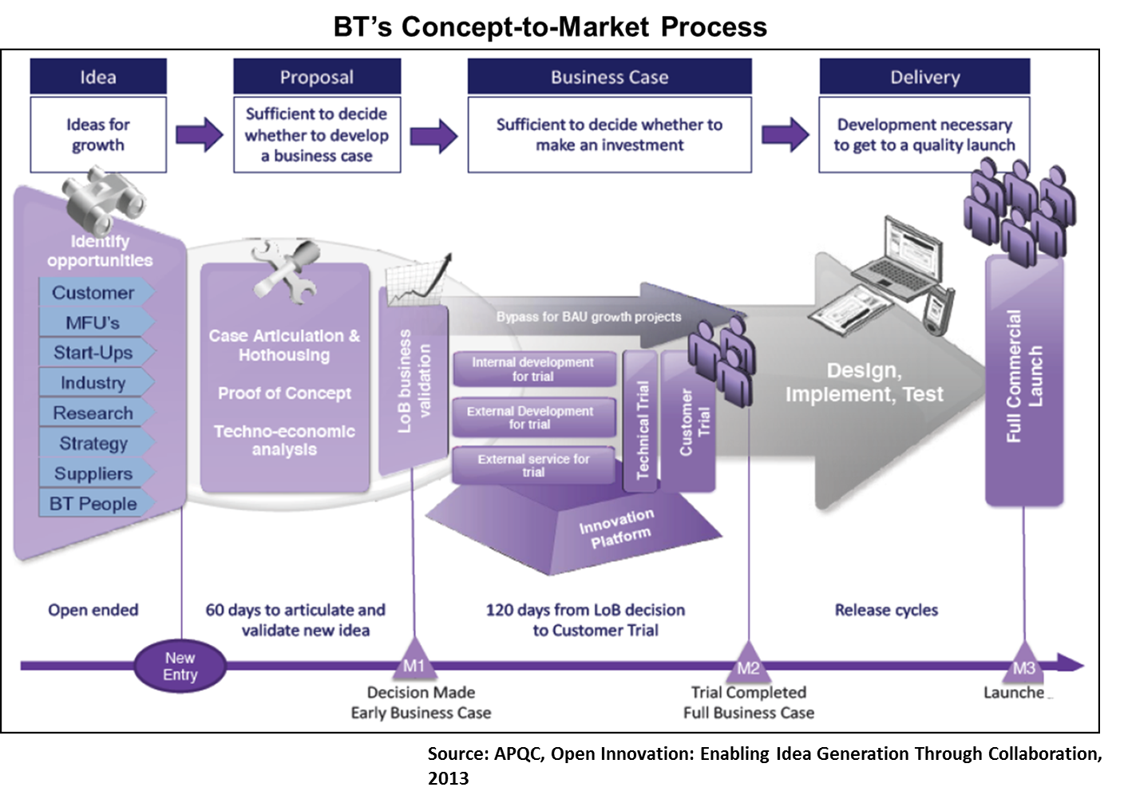
Adapting PM for Accelerated Value Delivery
Source: APQC. Open Innovation: Driving Idea Generation Through Collaboration, 2013.

Slide 34

Sign-Post: Integration
Integration is…
Having a shared set of objectives defined by the success of the overall effort…
Everyone knowing what those objectives are…
Clarity and understanding around everyone's roles and how they contribute to achieving the objectives…
Respecting the value of the others’ role and contribution to achieving the objectives…
Valuing and promoting “collaboration” over “competition”…

Slide 35


Slide 36
Discussion
Today, what inhibits or limits your ability to embrace agile and agility?
Which conditions can you control or change?
How can you help your teams embrace new ways of working?
What lessons learned from your past experiences might apply?

Slide 37
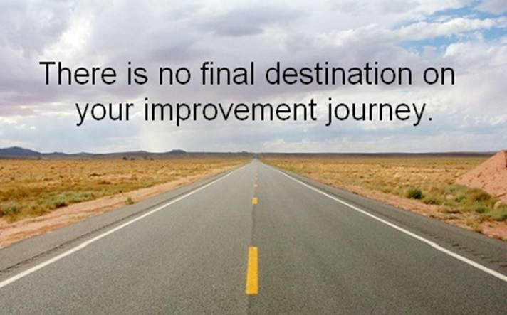

Slide 38
Exercise: See-Own-Do
DO: Specify one concrete action that you will take to RESOLVE, LEARN or ADVOCATE based on insights from our discussion.
Is your DO action something to which you can truly commit in its current form?
Would your DO work better with smaller micro-commitments?
Will your DO give you enough of a quick win to motivate your continued efforts?

Slide 40
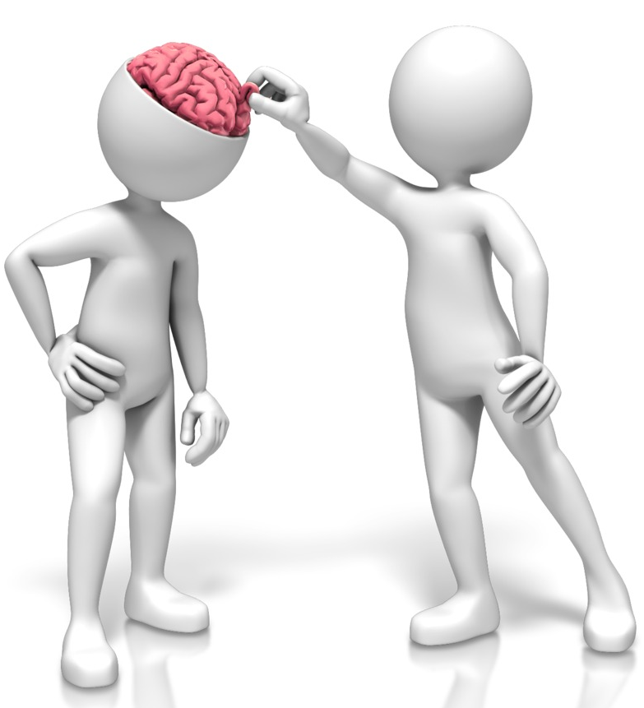
Final Reflections

Slide 41
Resources from PMI
Projectmanagement.com, PMI’s global community site with discussion groups, blogs, articles, tools/ templates, webinars on agile topics.
Books and publications, including:
Agile Practice Guide, available separately or bundled with the PMBOK® Guide
Leading Agile Teams by Doug Rose
Thought leadership and content
PMI Pulse of the Profession® reports
PMI Thought Leadership Series on organizational agility
Learning, development and Networking
PMI Ottawa Valley Chapter: http://www.pmiovoc.org/
Credentials
PMI-ACP® - Agile Certified Practitioner
PMI-PBA® - Professional in Business Analysis
PMP® - Project Management Professional

Slide 42
Resources from PMI
PMI Thought Leadership Series: Achieving Greater Agility: https://www.pmi.org/learning/thought-leadership/series/achieving-greater-agility.
PMI Pulse of the Profession®: The Project Manager of the Future: Developing Digital-Age Project Management Skills to Thrive In Disruptive Times: https://www.pmi.org/learning/thought-leadership/pulse/the-project-manager-of-the-future.
Projectified with PMI Podcast: Transformation — Momentum and Mindset: https://www.pmi.org/learning/training-development/projectified-podcast/podcasts/transformation-momentum-and-mindset.
Projectified with PMI Podcast: Digital Transformation — What It Takes: https://www.pmi.org/learning/training-development/projectified-podcast/podcasts/digital-transformation-what-it-takes.
Projectified with PMI Podcast: Agile Ways — An Ongoing Journey: https://www.pmi.org/learning/training-development/projectified-podcast/podcasts/agile-journey.

